Slide 1
Python NumPy Operations
Dr. Nikita Mishra
nikita.mishra@spit.ac.in
Sardar Patel Institute of Technology,
Bhavan's Campus, Munshi Nagar,
Andheri West,
Mumbai-400058

Slide 2
Outline
Introduction
Numpy array creation
NumPy Data Types
Numpy array slicing and Indexing
Array Operations
Numpy Broadcasting
Advanced Array operations

Slide 3
Introduction to Numpy
NumPy is a Python library created in 2005 that performs numerical calculations. It is generally used for working with arrays.
NumPy also includes a wide range of mathematical functions, such as linear algebra, Fourier transforms, and random number generation, which can be applied to arrays.
NumPy is an important library generally used for:
-Machine Learning
-Data Science
-Image and Signal Processing
-Scientific Computing
-Quantum Computing
Notes:
There is a remarkable advancement in mobile communication from simple voice-based devices to data hungry applications. The applications are augmented reality, virtual reality in games, audio, video streaming (Netflix, Hotstar, Youtube) services that are widely use by consumers. The sophisticated technology for smartphones display that enables users to view videos at high definitions has increased the demand for greater data capacity. Compared to 5G, 6G is expected to achieve a 100-fold increase in peak data rate (from Gbps to Tbps), a 10-fold reduction in latency, 10-fold improvement in connection density. Nearly, 8 billion mobile subscriber are expected to be added by 2030 and also require an extra spectrum to serve. The existing static spectrum allocation policy are not in a position to fullfil extra spectrum requirement and handle this traffic load.
The available spectrum is a finite resource, Spectrum scarcity is a critical challenge in modern wireless communication systems leading to congestion and inefficient usage.

Slide 4
Why Use NumPy?
Faster Execution
NumPy is heavily used with various libraries like Pandas, Scipy, scikit-learn, etc.
With its ability to perform element-wise operations, broadcasting, and vectorized computations, NumPy allows for more efficient and concise code, making it a cornerstone of modern data analysis and computational tasks in Python.
It provides support for large, multi-dimensional arrays and matrices, along with a collection of mathematical functions to operate on these arrays efficiently.
NumPy forms the foundation for many other data science and machine learning libraries, making it essential for handling numerical data.
Notes:
The most common everyday uses of the ISM bands are for low-power and short-range telecommunications, such as WiFi, Bluetooth, Zigbee, wireless telephones, RFID, and NFC (Near Field communication). Spectrum sharing among these diverse technologies raises serious coexistence problems in the ISM band that may lead to performance degradation or even to network malfunctioning Due to increasing demand of wireless applications, ISM frequency band is getting overcrowded (Spectrum Scarcity). ISM band congestion causes interference, reduced transmission range, limited scalability, and spectrum inefficiency. Currently, most wireless in-home technologies are operating in the unlicensed 2.4 GHz Industrial Scientific and Medical (ISM) band. Currently, most wireless in-home technologies are operating in the unlicensed 2.4 GHz Industrial Scientific and Medical (ISM) band.

Slide 5
NumPy array Vs List
Python Lists
Element Overhead: Lists in Python store additional information about each element, such as its type and reference count. This overhead can be significant when dealing with a large number of elements.
Datatype: Lists can hold different data types, but this can decrease memory efficiency and slow numerical operations.
Memory Fragmentation: Lists may not store elements in contiguous memory locations, causing memory fragmentation and inefficiency.
Performance: Lists are not optimized for numerical computations and may have slower mathematical operations due to Python’s interpretation overhead. They are generally used as general-purpose data structures.
Functionality: Lists can store any data type, but lack specialized NumPy functions for numerical operations.
Notes:
The most common everyday uses of the ISM bands are for low-power and short-range telecommunications, such as WiFi, Bluetooth, Zigbee, wireless telephones, RFID, and NFC (Near Field communication). Spectrum sharing among these diverse technologies raises serious coexistence problems in the ISM band that may lead to performance degradation or even to network malfunctioning Due to increasing demand of wireless applications, ISM frequency band is getting overcrowded (Spectrum Scarcity). ISM band congestion causes interference, reduced transmission range, limited scalability, and spectrum inefficiency. Currently, most wireless in-home technologies are operating in the unlicensed 2.4 GHz Industrial Scientific and Medical (ISM) band. Currently, most wireless in-home technologies are operating in the unlicensed 2.4 GHz Industrial Scientific and Medical (ISM) band.

Slide 6
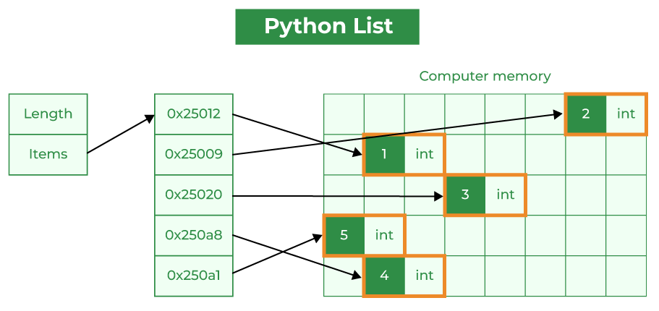
NumPy array Vs List
Notes:
The most common everyday uses of the ISM bands are for low-power and short-range telecommunications, such as WiFi, Bluetooth, Zigbee, wireless telephones, RFID, and NFC (Near Field communication). Spectrum sharing among these diverse technologies raises serious coexistence problems in the ISM band that may lead to performance degradation or even to network malfunctioning Due to increasing demand of wireless applications, ISM frequency band is getting overcrowded (Spectrum Scarcity). ISM band congestion causes interference, reduced transmission range, limited scalability, and spectrum inefficiency. Currently, most wireless in-home technologies are operating in the unlicensed 2.4 GHz Industrial Scientific and Medical (ISM) band. Currently, most wireless in-home technologies are operating in the unlicensed 2.4 GHz Industrial Scientific and Medical (ISM) band.

Slide 7
NumPy array Vs List
Numpy Arrays
Homogeneous Data: NumPy arrays store elements of the same data type, making them more compact and memory-efficient than lists.
Fixed Data Type: NumPy arrays have a fixed data type, reducing memory overhead by eliminating the need to store type information for each element.
Contiguous Memory: NumPy arrays store elements in adjacent memory locations, reducing fragmentation and allowing for efficient access.
Array Metadata: NumPy arrays have extra metadata like shape, strides, and data type. However, this overhead is usually smaller than the per-element overhead in lists.
Notes:
The most common everyday uses of the ISM bands are for low-power and short-range telecommunications, such as WiFi, Bluetooth, Zigbee, wireless telephones, RFID, and NFC (Near Field communication). Spectrum sharing among these diverse technologies raises serious coexistence problems in the ISM band that may lead to performance degradation or even to network malfunctioning Due to increasing demand of wireless applications, ISM frequency band is getting overcrowded (Spectrum Scarcity). ISM band congestion causes interference, reduced transmission range, limited scalability, and spectrum inefficiency. Currently, most wireless in-home technologies are operating in the unlicensed 2.4 GHz Industrial Scientific and Medical (ISM) band. Currently, most wireless in-home technologies are operating in the unlicensed 2.4 GHz Industrial Scientific and Medical (ISM) band.

Slide 8
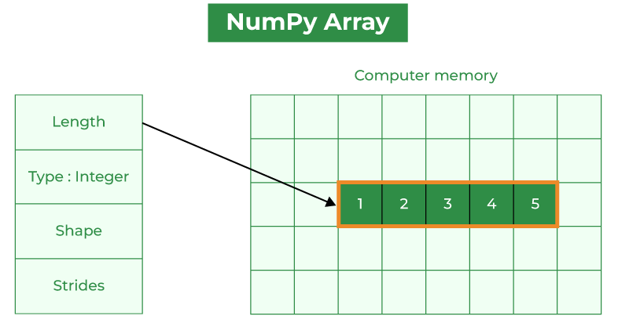
NumPy array Vs List
Notes:
The most common everyday uses of the ISM bands are for low-power and short-range telecommunications, such as WiFi, Bluetooth, Zigbee, wireless telephones, RFID, and NFC (Near Field communication). Spectrum sharing among these diverse technologies raises serious coexistence problems in the ISM band that may lead to performance degradation or even to network malfunctioning Due to increasing demand of wireless applications, ISM frequency band is getting overcrowded (Spectrum Scarcity). ISM band congestion causes interference, reduced transmission range, limited scalability, and spectrum inefficiency. Currently, most wireless in-home technologies are operating in the unlicensed 2.4 GHz Industrial Scientific and Medical (ISM) band. Currently, most wireless in-home technologies are operating in the unlicensed 2.4 GHz Industrial Scientific and Medical (ISM) band.

Slide 9
Why Use NumPy?
Advantages of using Numpy Arrays Over Python Lists:
Consumes less memory.
Fast as compared to the python List.
Convenient to use.
Notes:
The most common everyday uses of the ISM bands are for low-power and short-range telecommunications, such as WiFi, Bluetooth, Zigbee, wireless telephones, RFID, and NFC (Near Field communication). Spectrum sharing among these diverse technologies raises serious coexistence problems in the ISM band that may lead to performance degradation or even to network malfunctioning Due to increasing demand of wireless applications, ISM frequency band is getting overcrowded (Spectrum Scarcity). ISM band congestion causes interference, reduced transmission range, limited scalability, and spectrum inefficiency. Currently, most wireless in-home technologies are operating in the unlicensed 2.4 GHz Industrial Scientific and Medical (ISM) band. Currently, most wireless in-home technologies are operating in the unlicensed 2.4 GHz Industrial Scientific and Medical (ISM) band.

Slide 10
Why Use NumPy?
In Python we have lists that serve the purpose of arrays, but they are slow to process.
NumPy aims to provide an array object that is up to 50x faster than traditional Python lists.
The array object in NumPy is called ndarray, it provides a lot of supporting functions that make working with ndarray very easy.
Arrays are very frequently used in data science, where speed and resources are very important.
Notes:
The most common everyday uses of the ISM bands are for low-power and short-range telecommunications, such as WiFi, Bluetooth, Zigbee, wireless telephones, RFID, and NFC (Near Field communication). Spectrum sharing among these diverse technologies raises serious coexistence problems in the ISM band that may lead to performance degradation or even to network malfunctioning Due to increasing demand of wireless applications, ISM frequency band is getting overcrowded (Spectrum Scarcity). ISM band congestion causes interference, reduced transmission range, limited scalability, and spectrum inefficiency. Currently, most wireless in-home technologies are operating in the unlicensed 2.4 GHz Industrial Scientific and Medical (ISM) band. Currently, most wireless in-home technologies are operating in the unlicensed 2.4 GHz Industrial Scientific and Medical (ISM) band.

Slide 11
Installation of NumPy
If you have Python and PIP already installed on a system, then installation of NumPy is very easy.
pip install numpy
Once NumPy is installed, import it in your applications by adding the import keyword
NumPy is usually imported under the np alias.
alias: In Python alias are an alternate name for referring to the same thing.
import numpy as np
Notes:
The most common everyday uses of the ISM bands are for low-power and short-range telecommunications, such as WiFi, Bluetooth, Zigbee, wireless telephones, RFID, and NFC (Near Field communication). Spectrum sharing among these diverse technologies raises serious coexistence problems in the ISM band that may lead to performance degradation or even to network malfunctioning Due to increasing demand of wireless applications, ISM frequency band is getting overcrowded (Spectrum Scarcity). ISM band congestion causes interference, reduced transmission range, limited scalability, and spectrum inefficiency. Currently, most wireless in-home technologies are operating in the unlicensed 2.4 GHz Industrial Scientific and Medical (ISM) band. Currently, most wireless in-home technologies are operating in the unlicensed 2.4 GHz Industrial Scientific and Medical (ISM) band.

Slide 12
NumPy Array Creation
An array allows us to store a collection of multiple values in a single data structure.
The NumPy array is similar to a list, but with added benefits such as being faster and more memory efficient.
Numpy library provides various methods to work with data. To leverage all those features, we first need to create numpy arrays.
There are multiple techniques to generate arrays in NumPy, and we will explore each of them.
Notes:
Traditional Fixed Spectrum allocation Policy-Fixed Spectrums are not utilized efficiently. A large portion of the assigned spectrum is used sporadically as illustrated in Fig. below where the signal strength distribution over a large portion of the wireless spectrum is shown. The spectrum usage is concentrated on certain portions of the spectrum while a significant amount of the spectrum remains unutilized. Traditional static spectrum allocation policies, where spectrum bands are assigned exclusively to specific users or services, exacerbate this issue by leaving large portions of the spectrum underutilized.
Read more about ISM band 2.4-2.4835 GHz- Indoor - Low power wireless equipments- WifiIndoor use of low power wireless equipments in the frequency band 2.4GHz to 2.4835GHz.
2.4-2.4835 GHz- Low power wireless equipments- Zigbee - IEEE 802.15.4 (LR-WPANs)
Therefore, the demand for wireless connectivity, coverage, capacity, and services will continually expand. However, a critical bottleneck is the radio spectrum, a finite resource that cannot be readily expanded. For example, although theoretically ranging from 3 Hz to 3000 GHz, the entire spectrum is not usable; thus, the prime spectrum for current wireless standards may be roughly 1–5 GHz. This is because the spectrum below 1 GHz has already been reserved for applications such as radar, military communications, and terrestrial radio/television, while the spectrum above 5 GHz suffers from increased attenuation and atmospheric absorption. Therefore, the limited spectrum presents a roadblock for the rapid growth of wireless networks and users.
ISM stands for Industrial, Scientific, and Medical. It’s a range of frequencies that are unlicensed. Originally, those radio frequencies were reserved for non-telecommunication devices that would produce interference, such as microwave ovens, medical equipment, and the like.
In recent years, however, those bands have been used for low-power, short-range communications such as garage door openers, WiFi, cordless phones, Bluetooth, etc.
(Industrial, Scientific and Medical band) A part of the radio spectrum that can be used for any purpose without a license in most countries. In the U.S., the 902-928 MHz, 2.4 GHz and 5.7-5.8 GHz bands were initially used for machines that emitted radio frequencies, such as RF welders, industrial heaters and microwave ovens, but not for radio communications.
In 1985, the FCC Rules (Part 15.247) opened up the ISM bands for wireless LANs and mobile communications. In 1997, it added additional bands in the 5 GHz range under Part 15.407, known as the Unlicensed National Information Infrastructure (U-NII). Europe's HIPERLAN wireless LANs use the same 5 GHz bands, which are titled the "Broadband Radio Access Network."
Numerous applications use the ISM/U-NII bands, including cordless phones, wireless garage door openers, wireless microphones, vehicle tracking and amateur radio. S

Slide 13
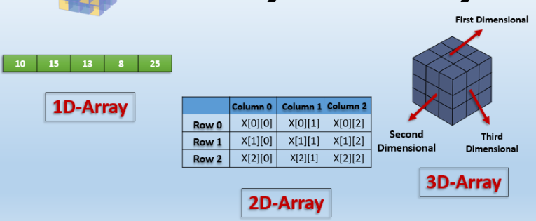
NumPy Array Creation
Notes:
Traditional Fixed Spectrum allocation Policy-Fixed Spectrums are not utilized efficiently. A large portion of the assigned spectrum is used sporadically as illustrated in Fig. below where the signal strength distribution over a large portion of the wireless spectrum is shown. The spectrum usage is concentrated on certain portions of the spectrum while a significant amount of the spectrum remains unutilized. Traditional static spectrum allocation policies, where spectrum bands are assigned exclusively to specific users or services, exacerbate this issue by leaving large portions of the spectrum underutilized.
Read more about ISM band 2.4-2.4835 GHz- Indoor - Low power wireless equipments- WifiIndoor use of low power wireless equipments in the frequency band 2.4GHz to 2.4835GHz.
2.4-2.4835 GHz- Low power wireless equipments- Zigbee - IEEE 802.15.4 (LR-WPANs)
Therefore, the demand for wireless connectivity, coverage, capacity, and services will continually expand. However, a critical bottleneck is the radio spectrum, a finite resource that cannot be readily expanded. For example, although theoretically ranging from 3 Hz to 3000 GHz, the entire spectrum is not usable; thus, the prime spectrum for current wireless standards may be roughly 1–5 GHz. This is because the spectrum below 1 GHz has already been reserved for applications such as radar, military communications, and terrestrial radio/television, while the spectrum above 5 GHz suffers from increased attenuation and atmospheric absorption. Therefore, the limited spectrum presents a roadblock for the rapid growth of wireless networks and users.
ISM stands for Industrial, Scientific, and Medical. It’s a range of frequencies that are unlicensed. Originally, those radio frequencies were reserved for non-telecommunication devices that would produce interference, such as microwave ovens, medical equipment, and the like.
In recent years, however, those bands have been used for low-power, short-range communications such as garage door openers, WiFi, cordless phones, Bluetooth, etc.
(Industrial, Scientific and Medical band) A part of the radio spectrum that can be used for any purpose without a license in most countries. In the U.S., the 902-928 MHz, 2.4 GHz and 5.7-5.8 GHz bands were initially used for machines that emitted radio frequencies, such as RF welders, industrial heaters and microwave ovens, but not for radio communications.
In 1985, the FCC Rules (Part 15.247) opened up the ISM bands for wireless LANs and mobile communications. In 1997, it added additional bands in the 5 GHz range under Part 15.407, known as the Unlicensed National Information Infrastructure (U-NII). Europe's HIPERLAN wireless LANs use the same 5 GHz bands, which are titled the "Broadband Radio Access Network."
Numerous applications use the ISM/U-NII bands, including cordless phones, wireless garage door openers, wireless microphones, vehicle tracking and amateur radio. S

Slide 14
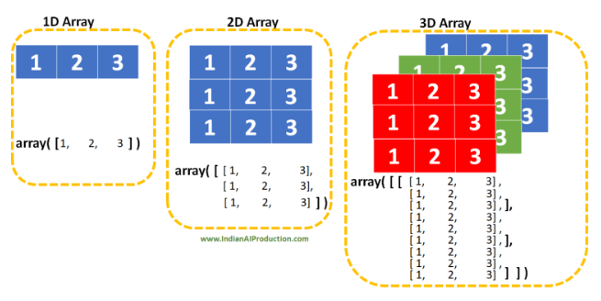
NumPy Array Creation
Notes:
Traditional Fixed Spectrum allocation Policy-Fixed Spectrums are not utilized efficiently. A large portion of the assigned spectrum is used sporadically as illustrated in Fig. below where the signal strength distribution over a large portion of the wireless spectrum is shown. The spectrum usage is concentrated on certain portions of the spectrum while a significant amount of the spectrum remains unutilized. Traditional static spectrum allocation policies, where spectrum bands are assigned exclusively to specific users or services, exacerbate this issue by leaving large portions of the spectrum underutilized.
Read more about ISM band 2.4-2.4835 GHz- Indoor - Low power wireless equipments- WifiIndoor use of low power wireless equipments in the frequency band 2.4GHz to 2.4835GHz.
2.4-2.4835 GHz- Low power wireless equipments- Zigbee - IEEE 802.15.4 (LR-WPANs)
Therefore, the demand for wireless connectivity, coverage, capacity, and services will continually expand. However, a critical bottleneck is the radio spectrum, a finite resource that cannot be readily expanded. For example, although theoretically ranging from 3 Hz to 3000 GHz, the entire spectrum is not usable; thus, the prime spectrum for current wireless standards may be roughly 1–5 GHz. This is because the spectrum below 1 GHz has already been reserved for applications such as radar, military communications, and terrestrial radio/television, while the spectrum above 5 GHz suffers from increased attenuation and atmospheric absorption. Therefore, the limited spectrum presents a roadblock for the rapid growth of wireless networks and users.
ISM stands for Industrial, Scientific, and Medical. It’s a range of frequencies that are unlicensed. Originally, those radio frequencies were reserved for non-telecommunication devices that would produce interference, such as microwave ovens, medical equipment, and the like.
In recent years, however, those bands have been used for low-power, short-range communications such as garage door openers, WiFi, cordless phones, Bluetooth, etc.
(Industrial, Scientific and Medical band) A part of the radio spectrum that can be used for any purpose without a license in most countries. In the U.S., the 902-928 MHz, 2.4 GHz and 5.7-5.8 GHz bands were initially used for machines that emitted radio frequencies, such as RF welders, industrial heaters and microwave ovens, but not for radio communications.
In 1985, the FCC Rules (Part 15.247) opened up the ISM bands for wireless LANs and mobile communications. In 1997, it added additional bands in the 5 GHz range under Part 15.407, known as the Unlicensed National Information Infrastructure (U-NII). Europe's HIPERLAN wireless LANs use the same 5 GHz bands, which are titled the "Broadband Radio Access Network."
Numerous applications use the ISM/U-NII bands, including cordless phones, wireless garage door openers, wireless microphones, vehicle tracking and amateur radio. S

Slide 15
NumPy Data Types
NumPy offers a wider range of numerical data types than what is available in Python.
Here's the list of most commonly used numeric data types in NumPy:
int8, int16, int32, int64 - signed integer types with different bit sizes
uint8, uint16, uint32, uint64 - unsigned integer types with different bit sizes
float32, float64 - floating-point types with different precision levels
complex64, complex128 - complex number types with different precision levels
Notes:
Although the fixed spectrum assignment policy generally served well in the past, there is a dramatic increase in the access to the limited spectrum for mobile services in the recent years. This increase is straining the effectiveness of the traditional spectrum policies.
The limited available spectrum and the inefficiency in the spectrum usage necessitate a new communication paradigm to exploit the existing wireless spectrum opportunistically.
A spectrum hole is a band of frequencies assigned to a primary user, but, at a particular time and specific geographic location, the band is not being utilized by that user.
Dynamic Spectrum Access (DSA) emerges as a viable solution to address spectrum scarcity by enhancing spectrum utilization efficiency. Unlike static allocation, DSA allows for real-time adjustment of spectrum usage based on demand and availability.

Slide 16
NumPy Array Attributes
In NumPy, attributes are properties of NumPy arrays that provide information about the array's shape, size, data type, dimension, and so on.
For example, to get the dimension of an array, we can use the ndim attribute.
Notes:
Although the fixed spectrum assignment policy generally served well in the past, there is a dramatic increase in the access to the limited spectrum for mobile services in the recent years. This increase is straining the effectiveness of the traditional spectrum policies.
The limited available spectrum and the inefficiency in the spectrum usage necessitate a new communication paradigm to exploit the existing wireless spectrum opportunistically.
A spectrum hole is a band of frequencies assigned to a primary user, but, at a particular time and specific geographic location, the band is not being utilized by that user.
Dynamic Spectrum Access (DSA) emerges as a viable solution to address spectrum scarcity by enhancing spectrum utilization efficiency. Unlike static allocation, DSA allows for real-time adjustment of spectrum usage based on demand and availability.

Slide 17
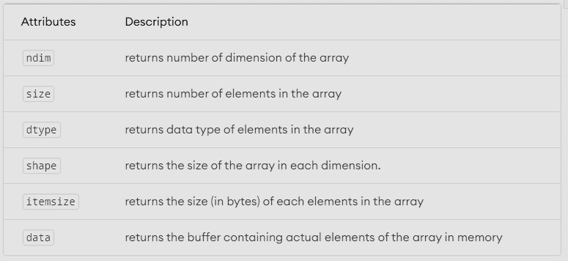
Common NumPy Attributes
Notes:
Although the fixed spectrum assignment policy generally served well in the past, there is a dramatic increase in the access to the limited spectrum for mobile services in the recent years. This increase is straining the effectiveness of the traditional spectrum policies.
The limited available spectrum and the inefficiency in the spectrum usage necessitate a new communication paradigm to exploit the existing wireless spectrum opportunistically.
A spectrum hole is a band of frequencies assigned to a primary user, but, at a particular time and specific geographic location, the band is not being utilized by that user.
Dynamic Spectrum Access (DSA) emerges as a viable solution to address spectrum scarcity by enhancing spectrum utilization efficiency. Unlike static allocation, DSA allows for real-time adjustment of spectrum usage based on demand and availability.

Slide 18
NumPy Input Output
NumPy offers input/output (I/O) functions for loading and saving data to and from files.
Input/output functions support a variety of file formats, including binary and text formats.
--The binary format is designed for efficient storage and retrieval of large arrays.
--The text format is more human-readable and can be easily edited in a text editor.
Notes:
Although the fixed spectrum assignment policy generally served well in the past, there is a dramatic increase in the access to the limited spectrum for mobile services in the recent years. This increase is straining the effectiveness of the traditional spectrum policies.
The limited available spectrum and the inefficiency in the spectrum usage necessitate a new communication paradigm to exploit the existing wireless spectrum opportunistically.
A spectrum hole is a band of frequencies assigned to a primary user, but, at a particular time and specific geographic location, the band is not being utilized by that user.
Dynamic Spectrum Access (DSA) emerges as a viable solution to address spectrum scarcity by enhancing spectrum utilization efficiency. Unlike static allocation, DSA allows for real-time adjustment of spectrum usage based on demand and availability.

Slide 19
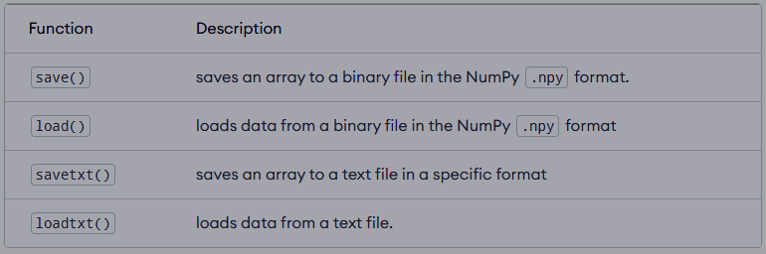
Most Commonly Used I/O Functions
Notes:
Although the fixed spectrum assignment policy generally served well in the past, there is a dramatic increase in the access to the limited spectrum for mobile services in the recent years. This increase is straining the effectiveness of the traditional spectrum policies.
The limited available spectrum and the inefficiency in the spectrum usage necessitate a new communication paradigm to exploit the existing wireless spectrum opportunistically.
A spectrum hole is a band of frequencies assigned to a primary user, but, at a particular time and specific geographic location, the band is not being utilized by that user.
Dynamic Spectrum Access (DSA) emerges as a viable solution to address spectrum scarcity by enhancing spectrum utilization efficiency. Unlike static allocation, DSA allows for real-time adjustment of spectrum usage based on demand and availability.

Slide 20


Numpy Array Indexing
In NumPy, each element in an array is associated with a number. The number is known as an array index.
Access Array Elements Using Index
array1 = np.array([1, 3, 5, 7, 9])
we can use the index number to access array elements as:
array1[0] - to access the first element, i.e. 1
array1[2] - to access the third element, i.e. 5
array1[4] - to access the fifth element, i.e. 9
Notes:
Although the fixed spectrum assignment policy generally served well in the past, there is a dramatic increase in the access to the limited spectrum for mobile services in the recent years. This increase is straining the effectiveness of the traditional spectrum policies.
The limited available spectrum and the inefficiency in the spectrum usage necessitate a new communication paradigm to exploit the existing wireless spectrum opportunistically.
A spectrum hole is a band of frequencies assigned to a primary user, but, at a particular time and specific geographic location, the band is not being utilized by that user.
Dynamic Spectrum Access (DSA) emerges as a viable solution to address spectrum scarcity by enhancing spectrum utilization efficiency. Unlike static allocation, DSA allows for real-time adjustment of spectrum usage based on demand and availability.

Slide 21
NumPy Array Slicing
Array Slicing is the process of extracting a portion of an array.
With slicing, we can easily access elements in the array. It can be done on one or more dimensions of a NumPy array.
array[start:stop:step]
start - index of the first element to be included in the slice
stop - index of the last element (exclusive)
step - step size between each element in the slice
When we slice arrays, the start index is inclusive, but the stop index is exclusive.
If we omit start, slicing starts from the first element
If we omit stop, slicing continues up to the last element
If we omit step, default step size is 1
Notes:
Although the fixed spectrum assignment policy generally served well in the past, there is a dramatic increase in the access to the limited spectrum for mobile services in the recent years. This increase is straining the effectiveness of the traditional spectrum policies.
The limited available spectrum and the inefficiency in the spectrum usage necessitate a new communication paradigm to exploit the existing wireless spectrum opportunistically.
A spectrum hole is a band of frequencies assigned to a primary user, but, at a particular time and specific geographic location, the band is not being utilized by that user.
Dynamic Spectrum Access (DSA) emerges as a viable solution to address spectrum scarcity by enhancing spectrum utilization efficiency. Unlike static allocation, DSA allows for real-time adjustment of spectrum usage based on demand and availability.

Slide 22
NumPy Array Reshaping
NumPy array reshaping simply means changing the shape of an array without changing its data.
The syntax of NumPy array reshaping is
np.reshape(array, newshape, order = 'C’)
array - input array that needs to be reshaped,
newshape - desired new shape of the array
order (optional) - specifies the order in which the elements of the array should be arranged. By default it is set to ‘C’
The order argument can take one of three values: 'C', 'F', or 'A'.
Notes:
Although the fixed spectrum assignment policy generally served well in the past, there is a dramatic increase in the access to the limited spectrum for mobile services in the recent years. This increase is straining the effectiveness of the traditional spectrum policies.
The limited available spectrum and the inefficiency in the spectrum usage necessitate a new communication paradigm to exploit the existing wireless spectrum opportunistically.
A spectrum hole is a band of frequencies assigned to a primary user, but, at a particular time and specific geographic location, the band is not being utilized by that user.
Dynamic Spectrum Access (DSA) emerges as a viable solution to address spectrum scarcity by enhancing spectrum utilization efficiency. Unlike static allocation, DSA allows for real-time adjustment of spectrum usage based on demand and availability.

Slide 23
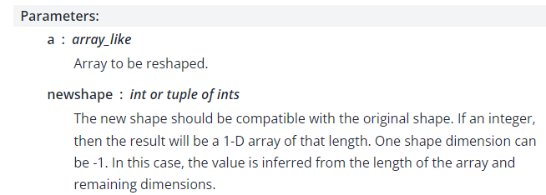
NumPy Array Reshaping
Gives a new shape to an array without changing its data.
Notes:
Although the fixed spectrum assignment policy generally served well in the past, there is a dramatic increase in the access to the limited spectrum for mobile services in the recent years. This increase is straining the effectiveness of the traditional spectrum policies.
The limited available spectrum and the inefficiency in the spectrum usage necessitate a new communication paradigm to exploit the existing wireless spectrum opportunistically.
A spectrum hole is a band of frequencies assigned to a primary user, but, at a particular time and specific geographic location, the band is not being utilized by that user.
Dynamic Spectrum Access (DSA) emerges as a viable solution to address spectrum scarcity by enhancing spectrum utilization efficiency. Unlike static allocation, DSA allows for real-time adjustment of spectrum usage based on demand and availability.

Slide 24
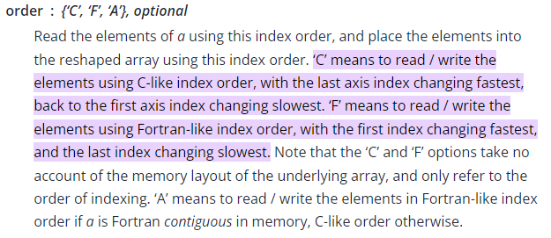
NumPy Array Reshaping
Notes:
Although the fixed spectrum assignment policy generally served well in the past, there is a dramatic increase in the access to the limited spectrum for mobile services in the recent years. This increase is straining the effectiveness of the traditional spectrum policies.
The limited available spectrum and the inefficiency in the spectrum usage necessitate a new communication paradigm to exploit the existing wireless spectrum opportunistically.
A spectrum hole is a band of frequencies assigned to a primary user, but, at a particular time and specific geographic location, the band is not being utilized by that user.
Dynamic Spectrum Access (DSA) emerges as a viable solution to address spectrum scarcity by enhancing spectrum utilization efficiency. Unlike static allocation, DSA allows for real-time adjustment of spectrum usage based on demand and availability.

Slide 25
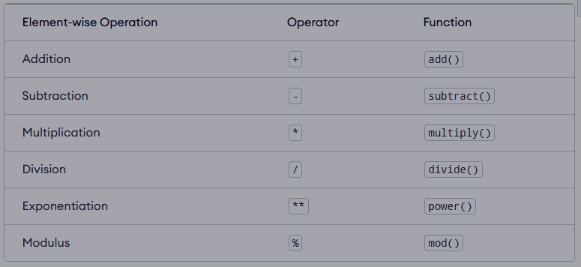
NumPy Arithmetic Array Operations
NumPy provides a wide range of operations that can perform on arrays, including arithmetic operations.
NumPy's arithmetic operations are widely used due to their ability to perform simple and efficient calculations on arrays.
To perform each operation, we can either use the associated operator or built-in functions.
Notes:
Although the fixed spectrum assignment policy generally served well in the past, there is a dramatic increase in the access to the limited spectrum for mobile services in the recent years. This increase is straining the effectiveness of the traditional spectrum policies.
The limited available spectrum and the inefficiency in the spectrum usage necessitate a new communication paradigm to exploit the existing wireless spectrum opportunistically.
A spectrum hole is a band of frequencies assigned to a primary user, but, at a particular time and specific geographic location, the band is not being utilized by that user.
Dynamic Spectrum Access (DSA) emerges as a viable solution to address spectrum scarcity by enhancing spectrum utilization efficiency. Unlike static allocation, DSA allows for real-time adjustment of spectrum usage based on demand and availability.

Slide 26
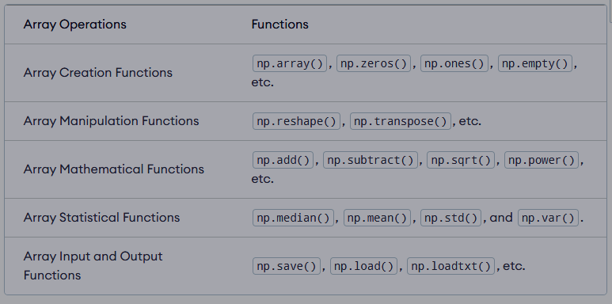
NumPy Array Functions
Common NumPy Array Functions
Notes:
Although the fixed spectrum assignment policy generally served well in the past, there is a dramatic increase in the access to the limited spectrum for mobile services in the recent years. This increase is straining the effectiveness of the traditional spectrum policies.
The limited available spectrum and the inefficiency in the spectrum usage necessitate a new communication paradigm to exploit the existing wireless spectrum opportunistically.
A spectrum hole is a band of frequencies assigned to a primary user, but, at a particular time and specific geographic location, the band is not being utilized by that user.
Dynamic Spectrum Access (DSA) emerges as a viable solution to address spectrum scarcity by enhancing spectrum utilization efficiency. Unlike static allocation, DSA allows for real-time adjustment of spectrum usage based on demand and availability.

Slide 27
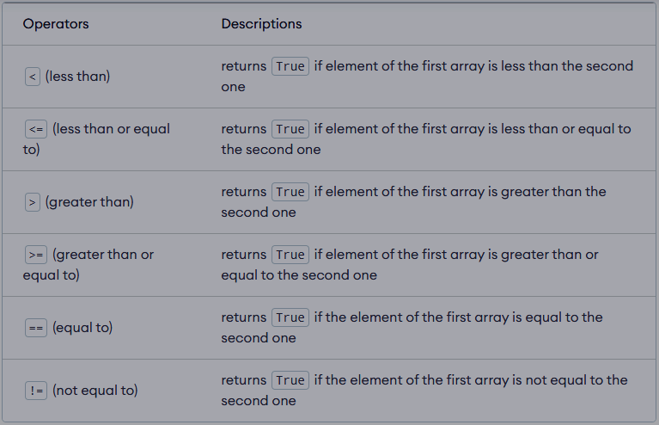
NumPy Comparison Operators
NumPy provides various element-wise comparison operators that can compare the elements of two NumPy arrays.
Notes:
Although the fixed spectrum assignment policy generally served well in the past, there is a dramatic increase in the access to the limited spectrum for mobile services in the recent years. This increase is straining the effectiveness of the traditional spectrum policies.
The limited available spectrum and the inefficiency in the spectrum usage necessitate a new communication paradigm to exploit the existing wireless spectrum opportunistically.
A spectrum hole is a band of frequencies assigned to a primary user, but, at a particular time and specific geographic location, the band is not being utilized by that user.
Dynamic Spectrum Access (DSA) emerges as a viable solution to address spectrum scarcity by enhancing spectrum utilization efficiency. Unlike static allocation, DSA allows for real-time adjustment of spectrum usage based on demand and availability.

Slide 28
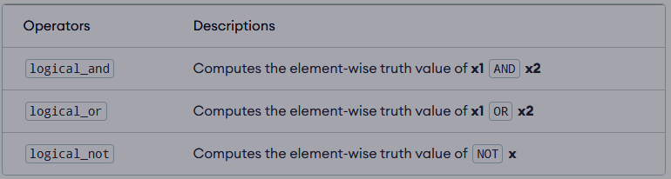
NumPy Logical Operations
Notes:
Although the fixed spectrum assignment policy generally served well in the past, there is a dramatic increase in the access to the limited spectrum for mobile services in the recent years. This increase is straining the effectiveness of the traditional spectrum policies.
The limited available spectrum and the inefficiency in the spectrum usage necessitate a new communication paradigm to exploit the existing wireless spectrum opportunistically.
A spectrum hole is a band of frequencies assigned to a primary user, but, at a particular time and specific geographic location, the band is not being utilized by that user.
Dynamic Spectrum Access (DSA) emerges as a viable solution to address spectrum scarcity by enhancing spectrum utilization efficiency. Unlike static allocation, DSA allows for real-time adjustment of spectrum usage based on demand and availability.

Slide 29
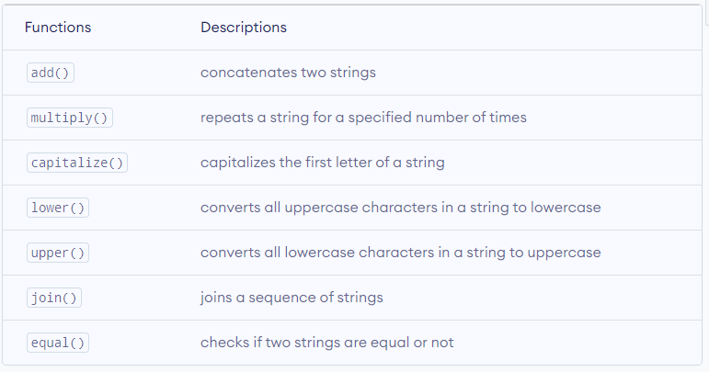
NumPy String Functions
We can add two strings, change the contents of a string, case conversion, padding, trimming, and so on.
Notes:
Although the fixed spectrum assignment policy generally served well in the past, there is a dramatic increase in the access to the limited spectrum for mobile services in the recent years. This increase is straining the effectiveness of the traditional spectrum policies.
The limited available spectrum and the inefficiency in the spectrum usage necessitate a new communication paradigm to exploit the existing wireless spectrum opportunistically.
A spectrum hole is a band of frequencies assigned to a primary user, but, at a particular time and specific geographic location, the band is not being utilized by that user.
Dynamic Spectrum Access (DSA) emerges as a viable solution to address spectrum scarcity by enhancing spectrum utilization efficiency. Unlike static allocation, DSA allows for real-time adjustment of spectrum usage based on demand and availability.

Slide 30
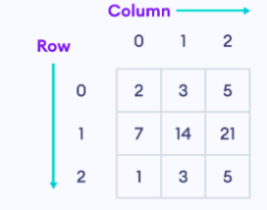
NumPy Matrix Operations
A matrix is a two-dimensional data structure where numbers are arranged into rows and columns. For example, matrix is a 3x3
Notes:
Although the fixed spectrum assignment policy generally served well in the past, there is a dramatic increase in the access to the limited spectrum for mobile services in the recent years. This increase is straining the effectiveness of the traditional spectrum policies.
The limited available spectrum and the inefficiency in the spectrum usage necessitate a new communication paradigm to exploit the existing wireless spectrum opportunistically.
A spectrum hole is a band of frequencies assigned to a primary user, but, at a particular time and specific geographic location, the band is not being utilized by that user.
Dynamic Spectrum Access (DSA) emerges as a viable solution to address spectrum scarcity by enhancing spectrum utilization efficiency. Unlike static allocation, DSA allows for real-time adjustment of spectrum usage based on demand and availability.

Slide 31
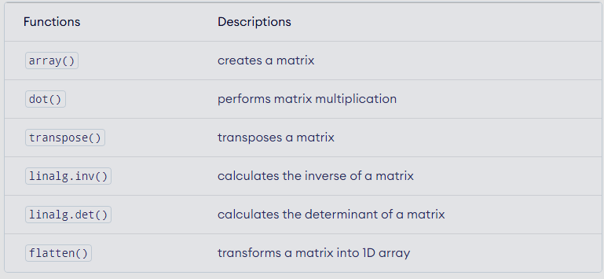
NumPy Matrix Operations
Notes:
Although the fixed spectrum assignment policy generally served well in the past, there is a dramatic increase in the access to the limited spectrum for mobile services in the recent years. This increase is straining the effectiveness of the traditional spectrum policies.
The limited available spectrum and the inefficiency in the spectrum usage necessitate a new communication paradigm to exploit the existing wireless spectrum opportunistically.
A spectrum hole is a band of frequencies assigned to a primary user, but, at a particular time and specific geographic location, the band is not being utilized by that user.
Dynamic Spectrum Access (DSA) emerges as a viable solution to address spectrum scarcity by enhancing spectrum utilization efficiency. Unlike static allocation, DSA allows for real-time adjustment of spectrum usage based on demand and availability.

Slide 32
NumPy Vectorization
NumPy vectorization involves performing mathematical operations on entire arrays, eliminating the need to loop through individual elements.
It refers to performing element-wise operations on arrays.
Notes:
Although the fixed spectrum assignment policy generally served well in the past, there is a dramatic increase in the access to the limited spectrum for mobile services in the recent years. This increase is straining the effectiveness of the traditional spectrum policies.
The limited available spectrum and the inefficiency in the spectrum usage necessitate a new communication paradigm to exploit the existing wireless spectrum opportunistically.
A spectrum hole is a band of frequencies assigned to a primary user, but, at a particular time and specific geographic location, the band is not being utilized by that user.
Dynamic Spectrum Access (DSA) emerges as a viable solution to address spectrum scarcity by enhancing spectrum utilization efficiency. Unlike static allocation, DSA allows for real-time adjustment of spectrum usage based on demand and availability.

Slide 33
NumPy Histogram
NumPy histograms is a graphical representation of the distribution of numerical data. Using functions like histogram() and plt(), we can create and plot histograms.
NumPy has a built-in function histogram() that takes an array of data as a parameter.
In histogram, a bin is a range of values that represents a group of data. bin is an optional parameter.
Notes:
Although the fixed spectrum assignment policy generally served well in the past, there is a dramatic increase in the access to the limited spectrum for mobile services in the recent years. This increase is straining the effectiveness of the traditional spectrum policies.
The limited available spectrum and the inefficiency in the spectrum usage necessitate a new communication paradigm to exploit the existing wireless spectrum opportunistically.
A spectrum hole is a band of frequencies assigned to a primary user, but, at a particular time and specific geographic location, the band is not being utilized by that user.
Dynamic Spectrum Access (DSA) emerges as a viable solution to address spectrum scarcity by enhancing spectrum utilization efficiency. Unlike static allocation, DSA allows for real-time adjustment of spectrum usage based on demand and availability.

Slide 34
NumPy Data Visualization
NumPy provides several techniques for data visualization like line plots, scatter plots, bar graphs, and histograms.
Data visualization allows us to have a visual representation of large amounts of data quickly and efficiently.
Notes:
Although the fixed spectrum assignment policy generally served well in the past, there is a dramatic increase in the access to the limited spectrum for mobile services in the recent years. This increase is straining the effectiveness of the traditional spectrum policies.
The limited available spectrum and the inefficiency in the spectrum usage necessitate a new communication paradigm to exploit the existing wireless spectrum opportunistically.
A spectrum hole is a band of frequencies assigned to a primary user, but, at a particular time and specific geographic location, the band is not being utilized by that user.
Dynamic Spectrum Access (DSA) emerges as a viable solution to address spectrum scarcity by enhancing spectrum utilization efficiency. Unlike static allocation, DSA allows for real-time adjustment of spectrum usage based on demand and availability.

Slide 35
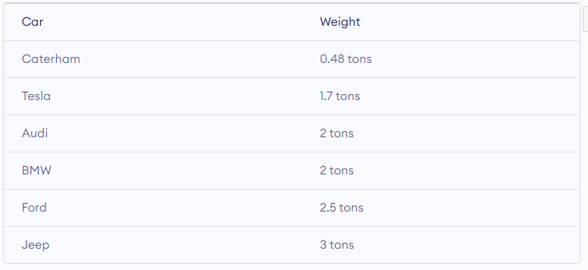
Dataset For Data Visualization
We'll be using the dataset of cars to visualize data.
Notes:
Although the fixed spectrum assignment policy generally served well in the past, there is a dramatic increase in the access to the limited spectrum for mobile services in the recent years. This increase is straining the effectiveness of the traditional spectrum policies.
The limited available spectrum and the inefficiency in the spectrum usage necessitate a new communication paradigm to exploit the existing wireless spectrum opportunistically.
A spectrum hole is a band of frequencies assigned to a primary user, but, at a particular time and specific geographic location, the band is not being utilized by that user.
Dynamic Spectrum Access (DSA) emerges as a viable solution to address spectrum scarcity by enhancing spectrum utilization efficiency. Unlike static allocation, DSA allows for real-time adjustment of spectrum usage based on demand and availability.

Slide 36
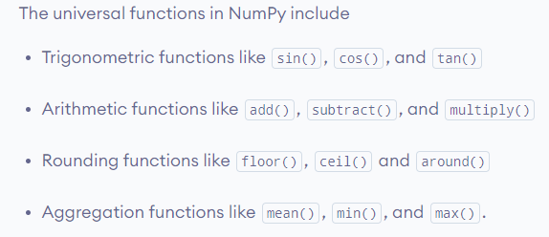
NumPy Universal Function
NumPy universal functions are mathematical functions that allow vectorization.
Vectorization refers to performing element-wise operations on arrays. Before you read this tutorial, make sure you understand vectorization.
Notes:
Although the fixed spectrum assignment policy generally served well in the past, there is a dramatic increase in the access to the limited spectrum for mobile services in the recent years. This increase is straining the effectiveness of the traditional spectrum policies.
The limited available spectrum and the inefficiency in the spectrum usage necessitate a new communication paradigm to exploit the existing wireless spectrum opportunistically.
A spectrum hole is a band of frequencies assigned to a primary user, but, at a particular time and specific geographic location, the band is not being utilized by that user.
Dynamic Spectrum Access (DSA) emerges as a viable solution to address spectrum scarcity by enhancing spectrum utilization efficiency. Unlike static allocation, DSA allows for real-time adjustment of spectrum usage based on demand and availability.

Slide 37
Conclusion
The presentation provides a comprehensive introduction to the NumPy library, covering essential topics such as array creation, manipulation, and various mathematical operations. By practicing the examples and exercises, you will develop a strong foundation in using NumPy for numerical computing and data analysis.
This knowledge will equip you with the skills necessary to efficiently handle large datasets, perform complex calculations, and implement advanced algorithms, making you well-prepared for further exploration in data science, machine learning, and scientific computing.
Notes:
In one cognitive radio cycle, a decision maker observes and learns the surrounding environment and modifies network parameters to maximize spectrum utilization efficiency. In one cognitive radio cycle, a decision maker observes and learns the surrounding environment and modifies network parameters to maximize spectrum utilization efficiency. This operation of CR is like the RL –Q learning procedure, in which an agent observes the environment or state, take appropriate actions to increase the overall reward of the network and finally update a Q matrix.
This operation of CR is like the RL –Q learning procedure, in which an agent observes the environment or state, take appropriate actions to increase the overall reward of the network and finally update a Q matrix.
A Q-table is a data structure of sets of actions and states, and Q-learning algorithm update the values in the table.
There is a loss of information in transition between discrete action time periods. However, when DQNs are used for continuous action spaces, quantization problems may emerge. A continuous action space generates more effective power allocation strategies under changing network conditions.
The Deep Deterministic Policy Gradient method is appropriate for RA because it offers two significant benefits: a) it is compatible with high-dimensional structures, and b) it selects precise action levels for continuous power allocation.
DDPG, TL, and MRL enhances convergence speed, sample efficiency, scalability, and ensures quick adaptation to changing environments for a resource allocation model.
As the studies illustrates, using an efficient learning approach improve the allocation of available resources. However, applying them in the practical environment makes the situation more challenging.
In a highly dynamic environment, the number of users and locations are constantly changing.
The DDPG algorithm consists of an actor-critic network suitable for continuous large actions and provides stable learning.
Combining DQN with DDPG can result in a solution that is compatible with continuous as well as discrete action spaces.
TL is a technique that can save time and efforts on both training and communication by reusing knowledge of experienced user.
The dynamics of meta reinforcement learning are derived by considering both the current and past actions. The purpose is to regularly update the model with information about its performance and parameters learned from previous tasks and observations.
The MRL algorithm facilitates faster learning, better scalability, and flexibility in response to changing channel circumstances

